Slide 1
PHYSICS
Mechanics
Thermodynamics
Electromagnetism
Optics

Slide 2
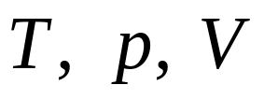
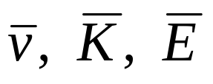
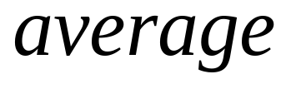
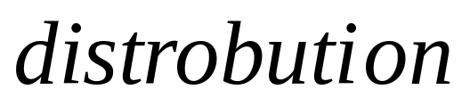

PHYSICS
Mechanics
Thermodynamics
Force law
One particle
Many particles
In random
environment
force
body
motion
Motion law

Slide 3
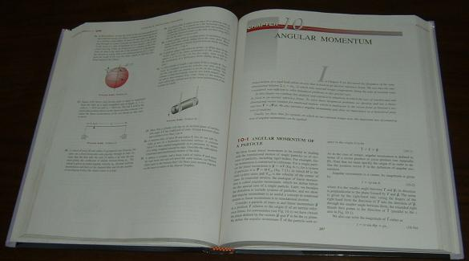
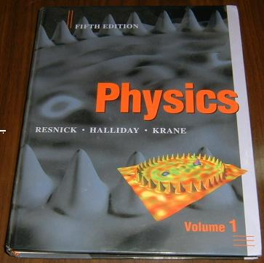
PHYSICS
Resnick, Halliday,
Krane

Slide 4
Experiment
is the base of
PHYSICS
Chap.1
Measurement

Slide 5
Experiment
is the base of
PHYSICS
Physical Quantities
Length, mass, time, force,
Speed, density, temperature
Current, magnetic field strength

Slide 6
Experiment
is the base of
PHYSICS
Physical Quantities
Length, mass, time, force,
Speed, density, temperature
Current, magnetic field strength

Slide 7
Standards and Units
Time (second, s)
1 s = 9192631770 vibration
of radiation emitted by
a cesium atom

Slide 8
Standards and Units
Length (meter, m)
Traveled by light in vacuum
during a time of 1/299792456 second

Slide 9
10⁻³ 10⁻⁴ 10⁻⁵ 10⁻⁶ 10⁻⁷ 10⁻⁸ 10⁻⁹ 10⁻¹⁰ m

Slide 10
10⁻³ 10⁻⁴ 10⁻⁵ 10⁻⁶ 10⁻⁷ 10⁻⁸ 10⁻⁹ 10⁻¹⁰ m
Microscope

Slide 11
10⁻³ 10⁻⁴ 10⁻⁵ 10⁻⁶ 10⁻⁷ 10⁻⁸ 10⁻⁹ 10⁻¹⁰ m
Microscope
Size of atom
Electron Microscope

Slide 12
10⁻³ 10⁻⁴ 10⁻⁵ 10⁻⁶ 10⁻⁷ 10⁻⁸ 10⁻⁹ 10⁻¹⁰ m
Microscope
Size of atom
Electron Microscope
Scanning Tunneling Microscopes (STM)

Slide 13
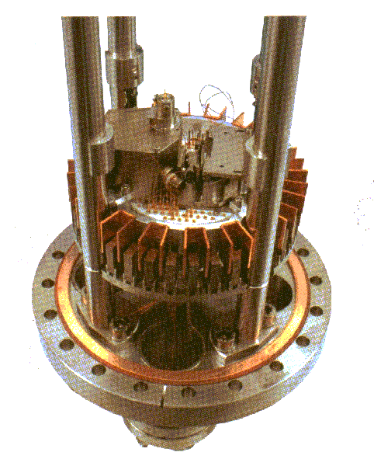
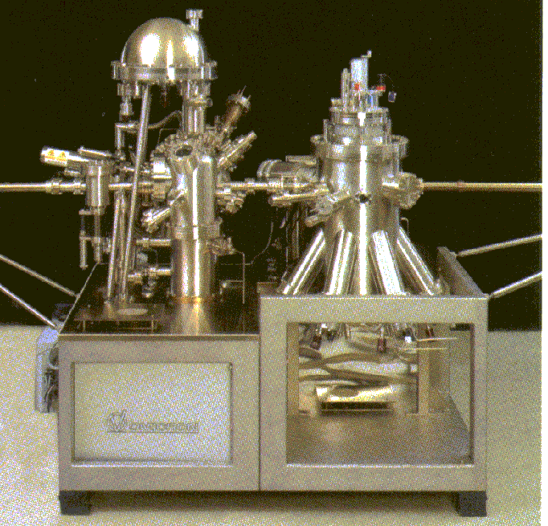
Scanning Tunneling Microscopes (STM)

Slide 14
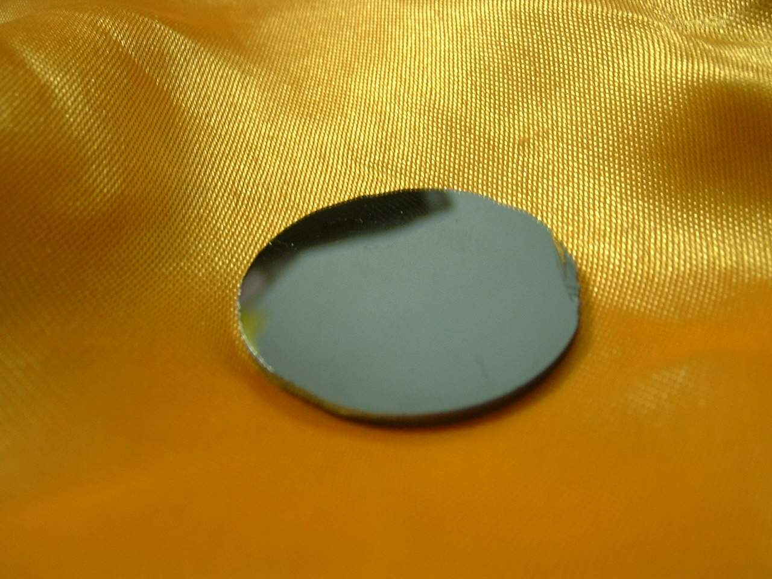
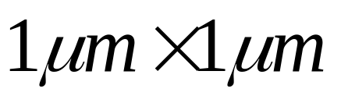
Si(111) Surface

Slide 15
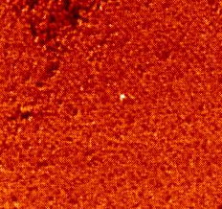
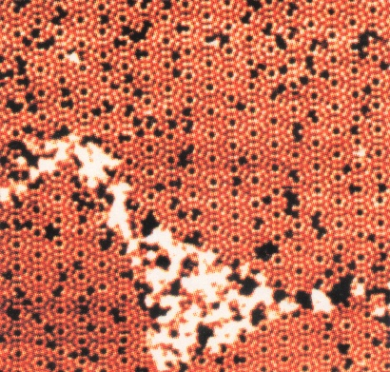
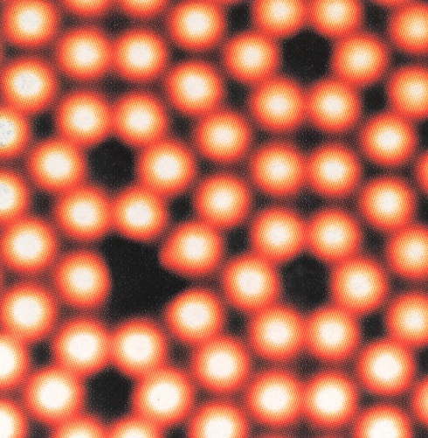
Si(111) Surface

Slide 16
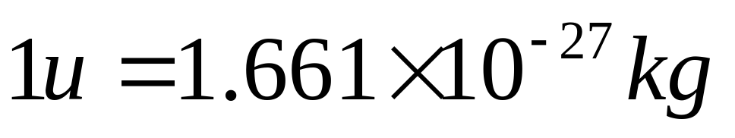
Standards and Units
Mass ( kilogram, Kg)
Standard of Mass as
“Prototype Kilogram No. 20”
Mass of ¹²C atom

Slide 17
Galaxy 10⁴³ kg
sun 10³⁰ kg
Earth 10²⁴ kg
person 10¹ kg
virus 10⁻¹⁵ kg
atom 10⁻²⁷ kg
electron 10⁻³¹ kg

Slide 18
Non-standards Units
Length
1 yard = 0.9144 meter
1 inch = 2.54 centimeters
1 light•year = 9.48 x 10¹⁵m

Slide 19
Non-standards Units
Mass
1 pound = 0.454 Kg
1 ounce = 0.02835 Kg

Slide 20
Dimension and dimensional analysis
M, L and T
mass, Length and time
[x]=L
[v]=LT⁻¹
[a]=LT⁻²
[f]=MLT⁻²

Slide 21
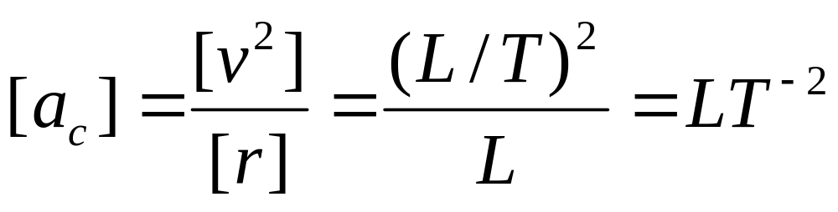
Example
Circular motion
Centripetal acceleration a_{c}=v²/r
a_{c}

